Slide 1
Tamponade

Slide 2
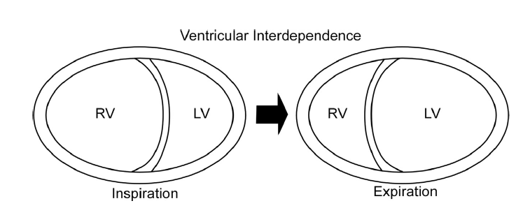
Wechselseitige Abhängigkeit der Kammern (interventricular dependence)
Die Perikardflüssigkeit erlaubt dem RV, die Füllung trotz des unelastischen parietalen Perikards in gewissem Maas zu steigern.
Erst bei deutlicher Überfüllung kommt es zu einer verminderten Füllung des linken Herzens.
Notes:
As noted, because of the many potential spaces and sinuses in the
pericardial sac, there is a small pericardial reserve volume of approximately
<50 mL.
Although relatively small, this amount is adequate to
allow increased right heart filling with normal inspiration without increased
pericardial restraint and increased right heart chamber pressures.
However, with marked swings in intrathoracic pressures due
to acute dyspnea, right heart filling during inspiration can exceed
the pericardial reserve volume, causing pericardial constraint and cardiac
pressures to increase.
This ‘‘overfilling’’ of the right heart may decrease
left heart filling through ventricular interdependence, the
process by which physical changes of one ventricle affect the other
(Figure 15).
These interactions occur chiefly in diastole and are due
to the inelastic parietal pericardium. Ventricular interdependence and interaction play a prominent role in the physiology of acute cardiac
dilation, cardiac tamponade, and CP.
The parietal pericardium exhibits a nonlinear pressure-volume relation.
There is an initial flat portion in the pressure-volume relation
whereby small changes in pericardial volume produce either no or
minimal change in pericardial pressure. However, once the pericardial
reserve volume is exceeded, there is an upward bend in pressure.
With additional volume, the curve rapidly steepens so that even small
increases in pericardial fluid result in large changes in pericardial pressure.
Thus, an acute, relatively small PEff may inhibit cardiac filling and
cause cardiac tamponade. On the other hand, a very large, chronic
PEff is seen with minimal hemodynamic effect if the fluid accumulation
is slow enough to enable the pericardium to stretch and grow,
which causes an increase in compliance by shifting its pressurevolume
relation to the right (Figure 16).28

Slide 3
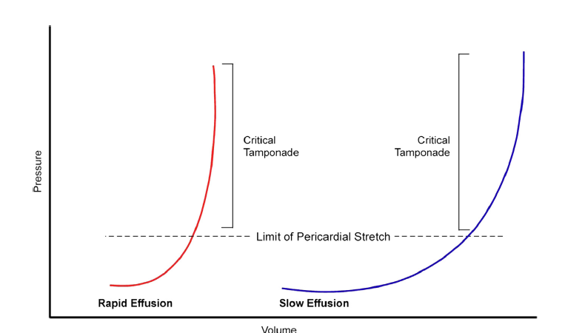
Druck-Volumen-Kurve
Das Perikard unterliegt einer Druck-Volumen-Beziehung. Zunächt führt eine Steigerung des Volumens zu nur gerinem Druck anstieg.
Durch einen Perikarderguss wird der Druckanstieg beschleunigt.
Chronische Perikardergüsse führen zu einr allmählichen Dehnung des Perikards, was die Druck-Volumen-Beziehung nach rechts verschiebt.
Notes:
and interaction play a prominent role in the physiology of acute cardiac
dilation, cardiac tamponade, and CP.
The parietal pericardium exhibits a nonlinear pressure-volume relation.
There is an initial flat portion in the pressure-volume relation
whereby small changes in pericardial volume produce either no or
minimal change in pericardial pressure. However, once the pericardial
reserve volume is exceeded, there is an upward bend in pressure.
With additional volume, the curve rapidly steepens so that even small
increases in pericardial fluid result in large changes in pericardial pressure.
Thus, an acute, relatively small PEff may inhibit cardiac filling and
cause cardiac tamponade. On the other hand, a very large, chronic
PEff is seen with minimal hemodynamic effect if the fluid accumulation
is slow enough to enable the pericardium to stretch and grow,
which causes an increase in compliance by shifting its pressurevolume
relation to the right (Figure 16).28

Slide 4
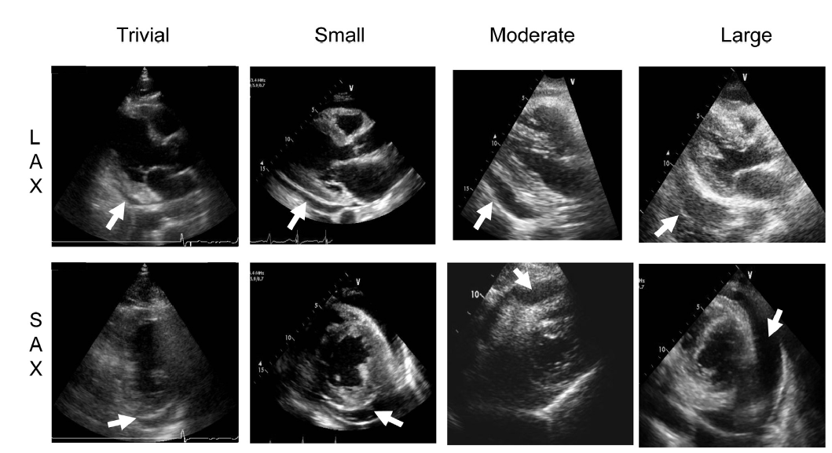
Abstufung der Perikardergussgröße in der PLAX und PSAX-Anlotung
Perikardseparation
  Nur in der Systole sichtbarer Erguss. (<50ml, normal)
Geringer Erguss
  Enddiastolisch < 10mm
Mäßiger Erguss
  Enddiastolisch < 20mm
Ausgeprägter Erguss
  Enddiastolisch > 20mm

Slide 5
Exsudativer Perikarderguss
Schwieriger zu erkennen,
Im Gegensatz zu transudativen Ergüssen nicht echofrei
Können randständige Verdichtungen, Adhäsionen und Clots enthalten
Ungleiche Verteilung

Slide 6
Perikardtamponade

Slide 7
Perikardtamponade: M-Mode SC-Blick
Systole
  RV geht wie normal nach innen
Beginn Diastole
  Kammerdruck fällt unter Perikarddruck
  Frühdiaastolischer Kollaps = dC
  Dann wieder steigendder Druck in der Kammer mit der Füllung
Notes:
Two-dimensional subcostal view of the heart in a patient with a pericardial effusion (PEff) and cardiac tamponade. An
M-mode cursor is placed across the RV free wall (Fr-Wall) to show the timing and duration of diastolic RV indentation or ‘‘collapse’’
(dC). During systole (Sys), the right ventricle contracts and moves inward, as expected. However, after the end of RV systole (thin
arrows on the electrocardiogram) RV relaxation causes intracavitary pressure to fall below pericardial pressure, resulting in early
diastolic RV collapse (dC). Subsequently, as RV filling occurs, the chamber pressure increases, and the myocardial wall moves
back toward the parietal pericardium. Maximum RV chamber size occurs after atrial contraction.

Slide 8
Parikardtamponade: atemabhängige E-Welle des Mitraleinstromprofils
Geringste E-Welle mit dem ersten Schlag in der Inspiration
Höchste E-welle mit dem ersten Schlag in der Expiration.
Zunahme (Diff/Max) > 30%
Notes:
PW Doppler recording of mitral inflow with a respirometer in a patient with cardiac tamponade. Peak velocities and
velocity-time integrals are low, reflecting the reduced cardiac output. There is increased respiratory variation in peak E-wave inflow
(E) velocity compared with normal, with the lowest values on the first beat of inspiration (insp) and the highest values on the first beat of
expiration (exp). The beats in between inspiration and expiration have intermediate values. From expiration to inspiration, the decrease
in peak mitral E-wave velocity exceeds 30%, as is typical in significant tamponade. Note that percentage of respiratory variation
for mitral inflow should be calculated as (expiration inspiration)/expiration based on the consensus of the Writing Group

Slide 9
Parikardtamponade: atemabhängige E-Welle des Trikuspidaleinstromprofils
Das Verhältnis E-Welle (TK) Inspiration/Expiration verhält sich genau umgekehrt
Notes:
PW Doppler recording of tricuspid inflow in a patient with cardiac tamponade. Peak velocities and velocity-time integrals
are low reflecting the reduced cardiac output. There is increased respiratory variation in peak E-wave inflow velocity compared with
normal (white dots), with the highest value on the first beat of inspiration (insp) and the lowest values on the first beat of expiration
(exp). These respiratory changes are opposite to those seen in mitral flow velocity (Figure 36). Note that percentage of respiratory
variation for tricuspid inflow should be calculated as (expiration inspiration)/expiration based on the consensus of the Writing
Group.

Slide 10
Perikardtamponade: Atem-Abhängigkeit von VTI(LVOT)
Bei einer Perikard-tamponade ist bei maximaler Inspiration VTI(LVOT ) am kleinsten.

Slide 11
Lebervenenfluss bei der Perikardtamponade
Bei einer Perikardtamponade zeigt der Lebervenenfluss währen der Expiration eine diastolische Flussumkehr und während der Inspiration eine allmähliche Zunahme des antegraden Flusses in der Systole und Diastoole.
Notes:
PW Doppler recording of hepatic venous flow velocity in a patient with cardiac tamponade. Flow below the zero baseline is
toward the heart and above the baseline is reverse flow. Compared with normal forward flow, velocities in tamponade are markedly
reduced, reflecting reduced cardiac filling. During apnea, forward flow is seen only during ventricular systole (S). With inspiration
(insp), systolic flow predominates, but diastolic flow (D) also appears. On the first beat of expiration (exp), there is a diastolic flow reversal (arrow). This reversal is at the same time tricuspid inflow is lowest (Figure 34). SVC flow velocity (not shown) continues to show
some diastolic forward flow on this first beat of expiration.

Slide 12
M-Mode PLAX bei Perikardtamponade
Bei der Perikardtamponade zeigt sich im M-Mode in der PLAX-LV-Anlotung im ersten Schlag nach Inspirationsbeginn eine Vergrößerung des RV und eine Verkleinerung des LV im Veergleich zu Schlägen während der Expiration.

Slide 13
Transienter Kollaps von RV und RA
Im 2D-Clip in der SC-Anlotung läßt sich in einigen Fällen einen transienten Kollaps des RV und des RA zu unterschiedlichen Zeiten beobachten. Der RV-Druck ist in der ersten Hälfte der Diastole am niedrigsten, der RA-Druck zu Beginn der Systole. Zu diesen Zeitpunkten werden die transiente Kollapszustände sichtbar.

Slide 14
IVC bei Perkardtamponade
Bei der Perikardtamponade sieht man eine gestaut IVC (> 2,0 cm), die nicht atemvariabel ist (<50%).

Slide 15
Differenzierung Perikarderguss und Pleuraerguss im Echo
Der Pleuraerguss verläuft in der PLAX-LV hinter der Aorta descendens, nicht so der Perikarderguss.

